Slide 1
21st Century Consumer Protection=Privacy+Digital Marketing Applications, esp. finance, health, other sensitive transactions

Slide 2
Consumer Rights in Data Driven Automated Marketplace

Slide 4
What Safeguards required?
Transparency, Fairness, Accountability, Heightened Control for “sensitive” categories, Protection for Most Vulnerable, Privacy. “Digital Due Process”

Slide 5
CDD: Working on Privacy & Digital Consumer Protection Since Early 1990’s

Slide 6
Digital Data”1993-2015

Slide 7
Global Financial Crisis: Online Lead Generation/Subprime

Slide 10
Era of Commercial Surveillance: Big Data

Slide 11
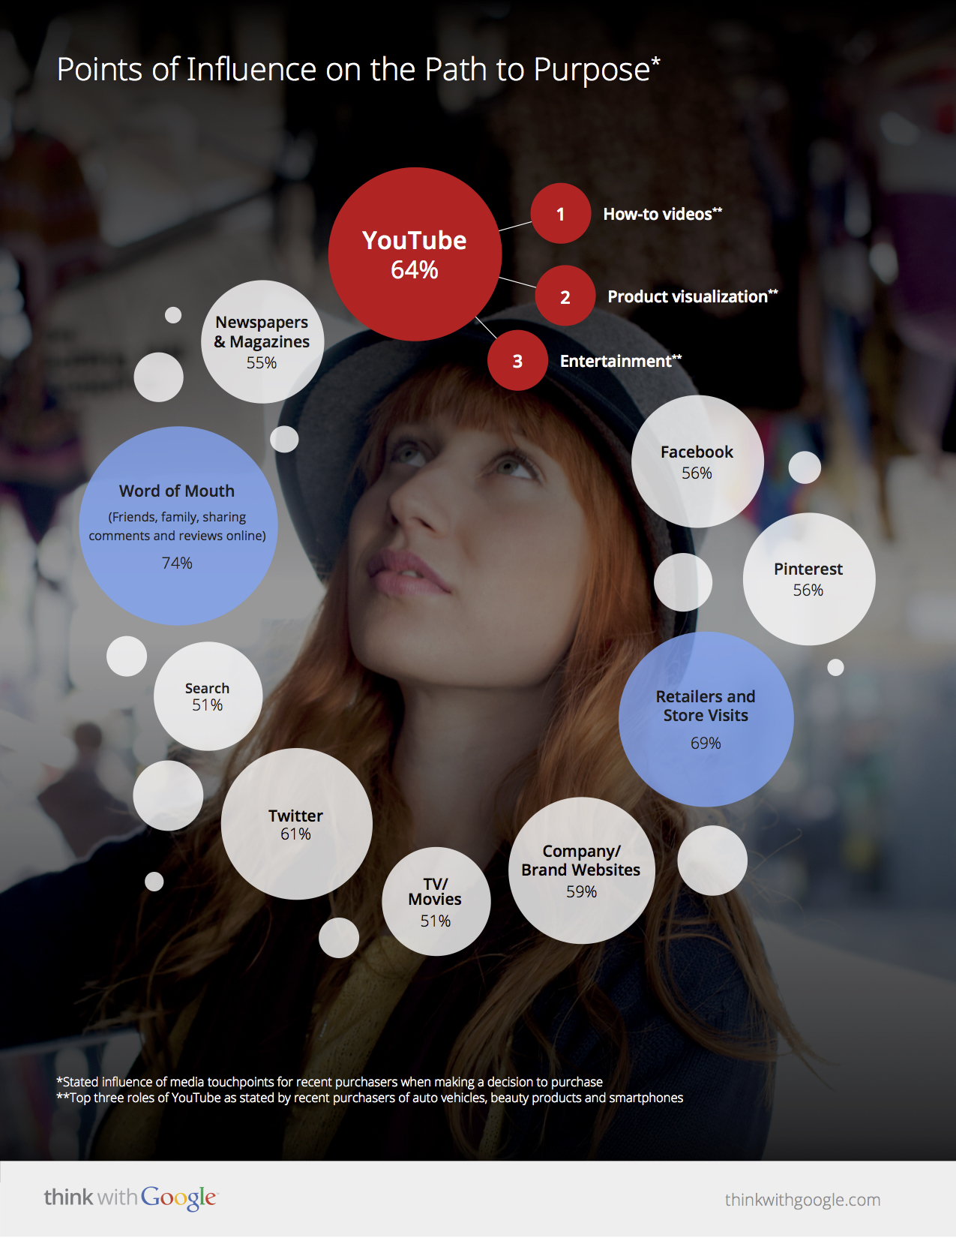

Slide 12
Big data is now driving the growth and expansion of marketing.
Targeting individuals and social groups/offline & online
Fully-automated, “always-on” tracking
Triggering and measuring actions in real time
Levels of precision unprecedented
Shaping content and functionality

Slide 13
Mobile as dominant device (apps, geo-location)
Notes:
Mondelez's Benin Bough says that there is an "overlap between the moments that consumers choose to make a snacking decision and the times when mobile usage spikes highest...”
"From a media standpoint, the most disruptive force today is mobile. It's transforming consumer behavior across all touch points, from in-store and television to outdoor...there are seven billion people in the world, 5.2 billion mobile phones and only 4.1 billion toothbrushes. We've clearly come to a place where this is a scale that's unprecedented...

Slide 14
They Know Your Location, Geographic History, Behaviors

Slide 18
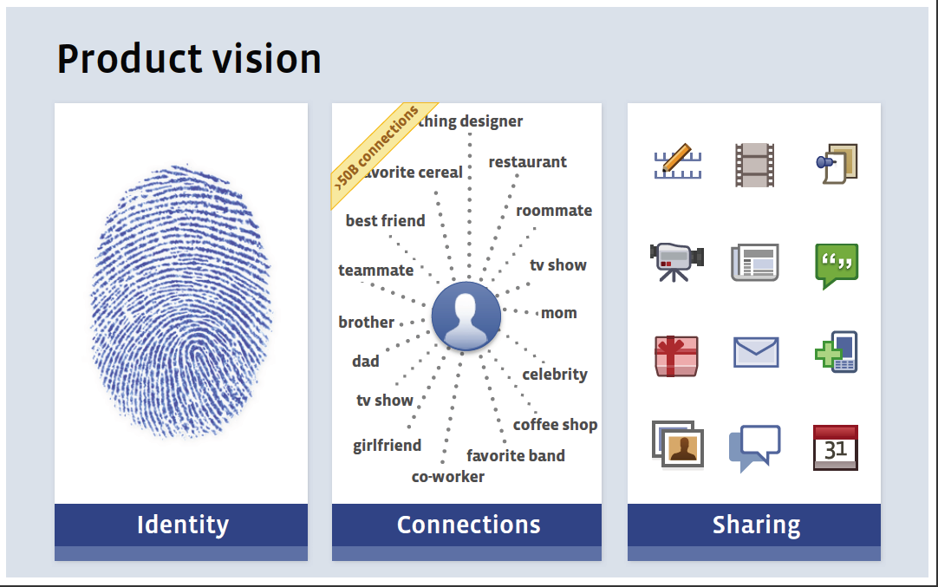
Marketing through the Social Graph

Slide 19
Data Targeting of Individuals/Anywhere/Anytime

Slide 20
A single consumer sold in milliseconds, web/mobile/TV

Slide 21
Key Features of Contemporary Marketing
“360 degree,” multi-platform ubiquity
Data collection & behavioral profiling
Immersive virtual environments
Woven into communication and social interactions
Mobile and location targeting
User generated, co-created ads
New metrics – Integration of content, marketing, & sales

Slide 22
Features of Contemporary Marketing
Advertising, marketing embedded in major platforms, applications (content & marketing intertwined)
Data collection—offline and online—at its core (individual, social network, geo-location/community)
Marketers focused on lifelong “engagement” using integrated Big-Data digitally-driven practices. “Story-telling,” branded content/experiences. Continuous campaigns
“Smart” ads, personalized—they learn about you and change in real-time
Growing focus on neuromarketing, unconscious
System of Influence/Behavioral change

Slide 23
Features of Contemporary Marketing
Data on individual used to “predict” and then “optimize” behavioral actions
Data points can include race/ethnicity, income, health, political interests, geography (real time offline/online+Big Data analysis). E-scores/new forms of user classification. Possible discrimination
Data-driven marketing engines identify points of vulnerability for targeting

Slide 24
Social Surveillance

Slide 25
Notes:
Liveramp data partners

Slide 26
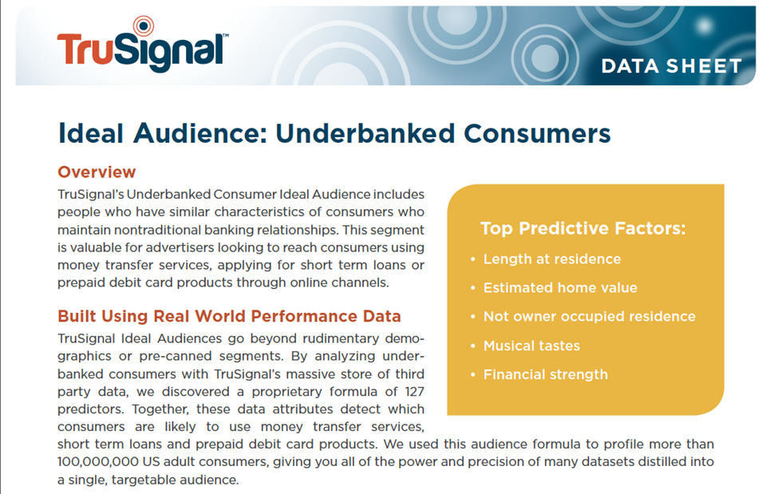

Slide 27
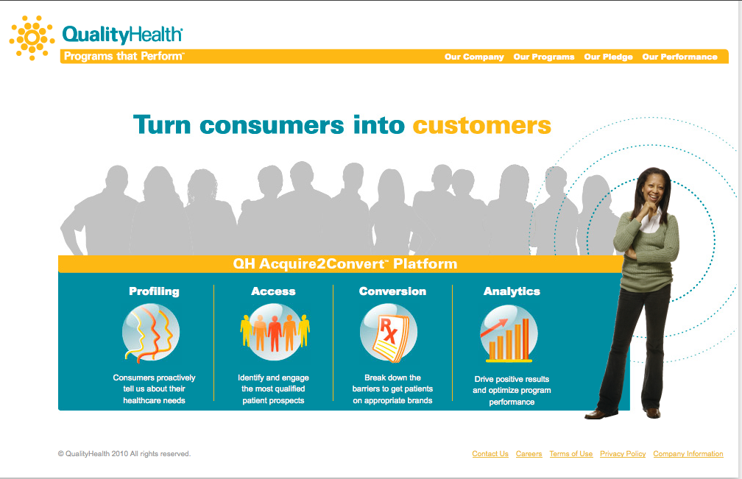

Slide 30
Targeting Teens: No safeguards

Slide 31
Quantified Self/IoT

Slide 32
Policy Issues/TTIP/Data Protection
Address relationship between data collection, digital marketing applications and consumer transactions, esp. financial, health, youth.
Work closely with privacy enforcers, such as DPAs, to connect the role of data collection in contemp. consumer services.
Support stronger rules on data protection (EU) and address new threats to consumer protection regulation, such as in TTIP and other trade deals. Reg. Coherence, ISDS
Work with regional and global NGOs, such as TACD, PI, CI. Stay on top of changing developments.

